Slide 1
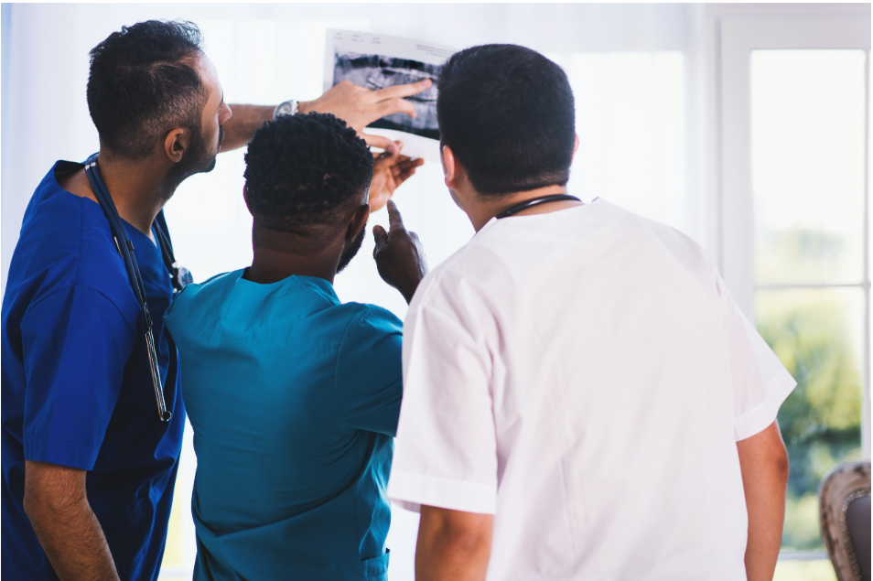
HEALTHCARE ANALYSIS
By: Jermaine Sangiwa

Slide 2
BACKGROUND INFORMATIOIN
As a Healthcare Analyst, I’ve been asked to analyse the hospital records to track the progress of some common illnesses so that the public health programme is well informed.

Slide 3
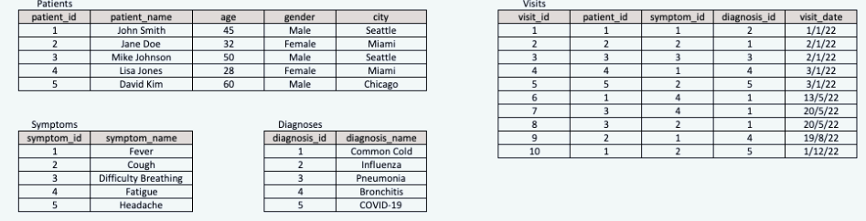
Dataset

Slide 4
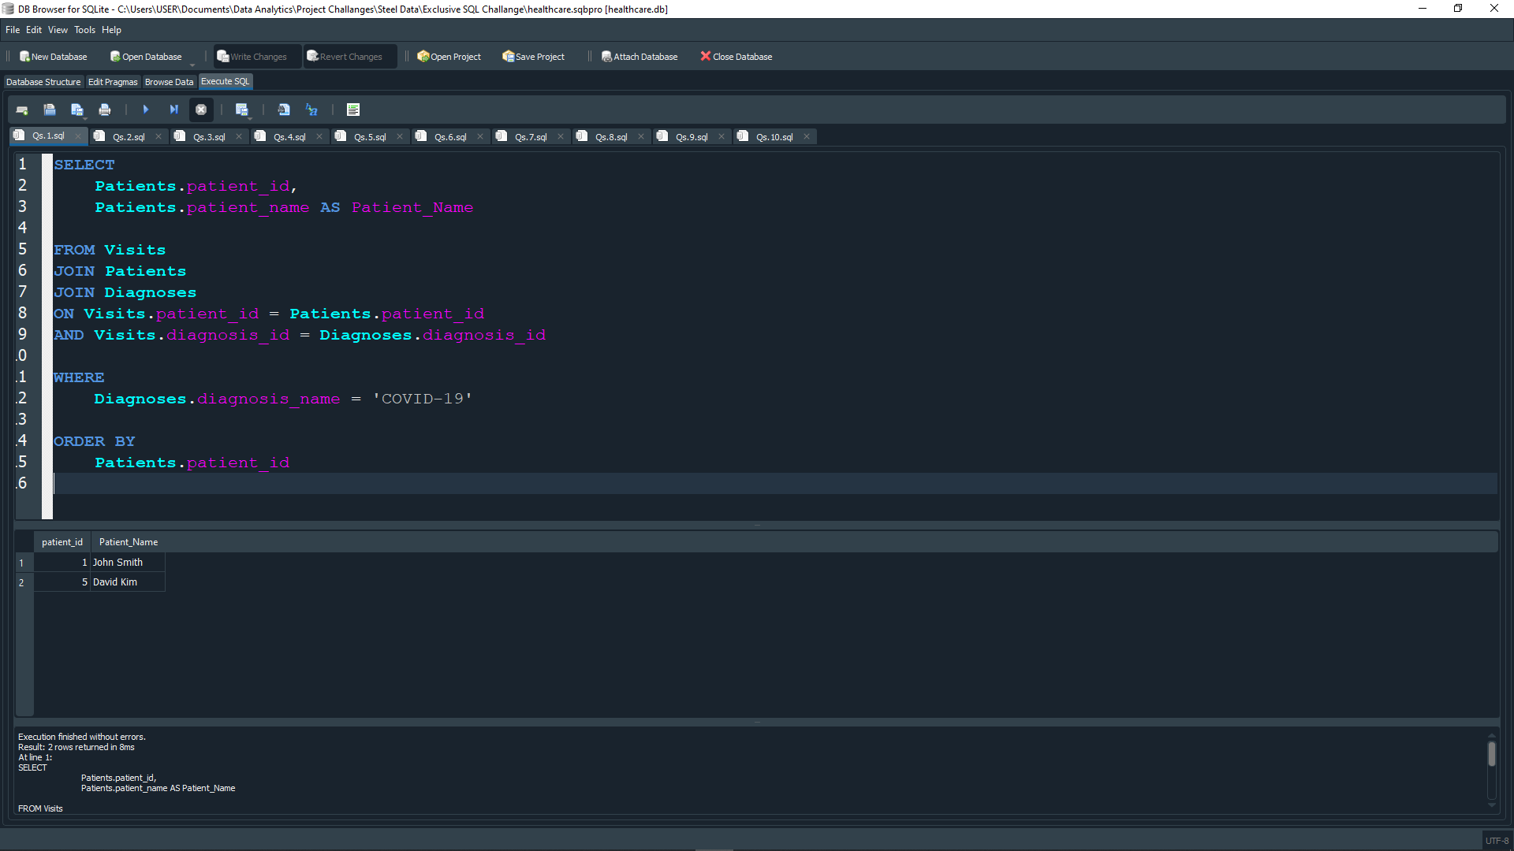
QUESTION 1: WRITE A SQL QUERY TO RETRIEVE ALL PATIENTS WHO HAVE BEEN DIAGNOSED WITH ‘COVID-19’.

Slide 5
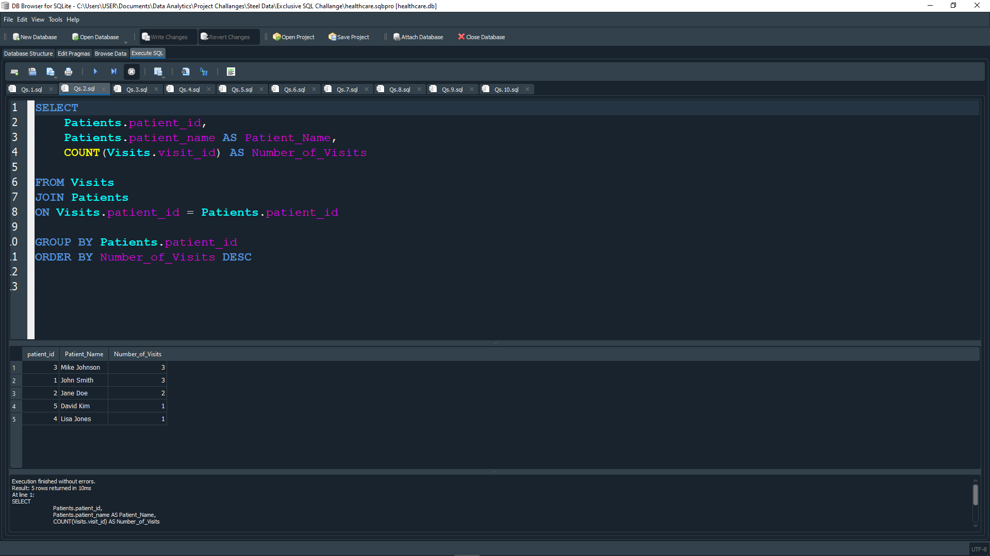
QUESTION 2: write a SQL query to retrieve the number of visits made by each patients, ordered by the number of visits in descending order

Slide 6
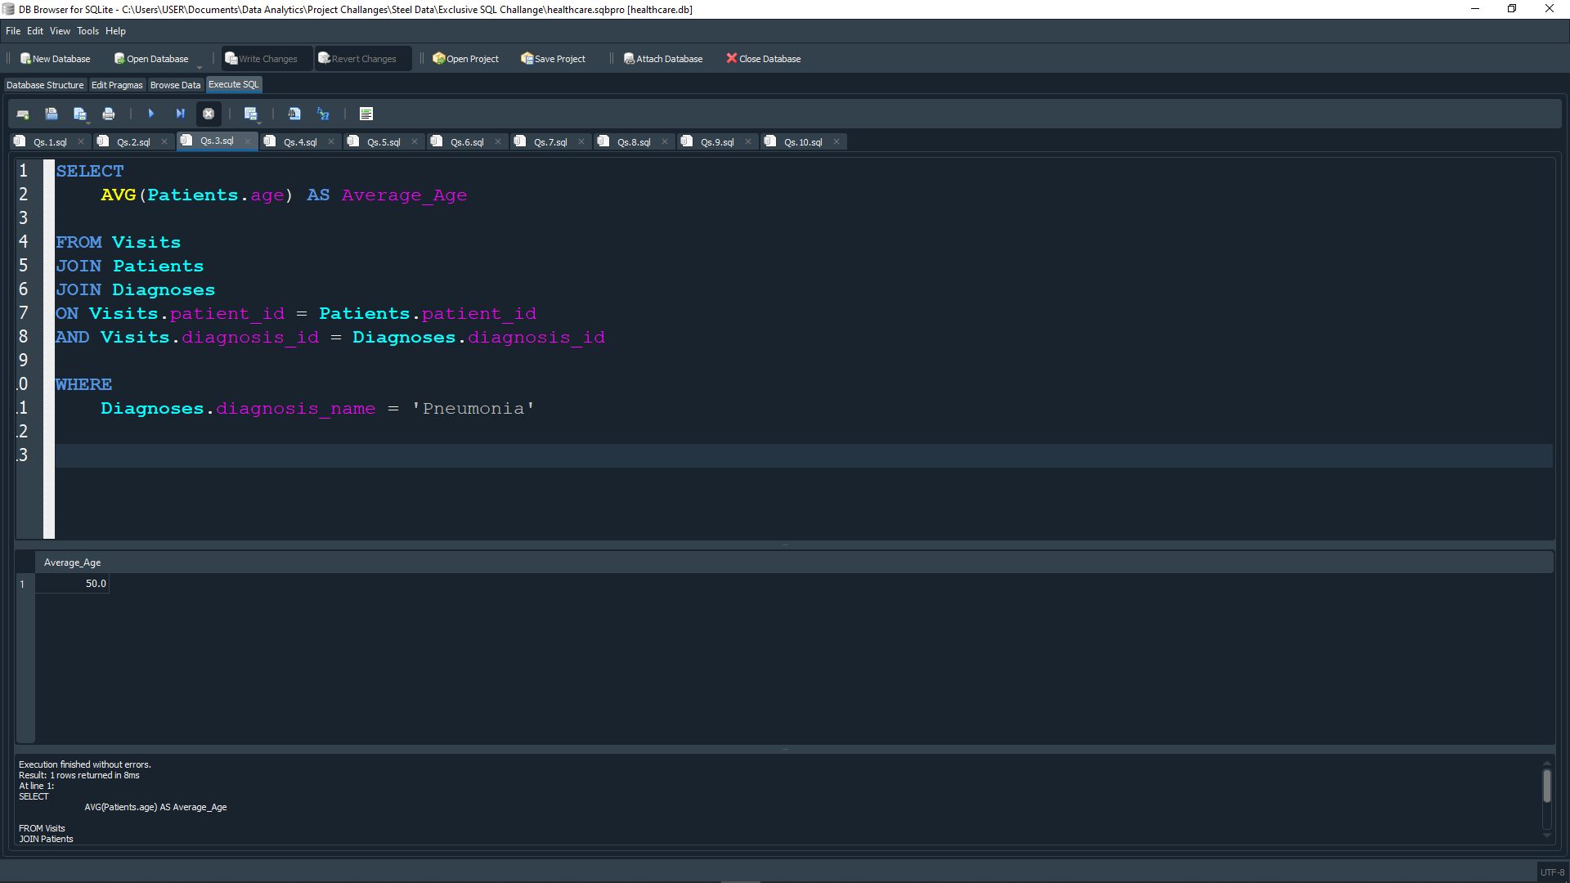
Question 3: Write a SQL query to calculate the average age of patient who have been diagnosed with pneumonia.

Slide 7
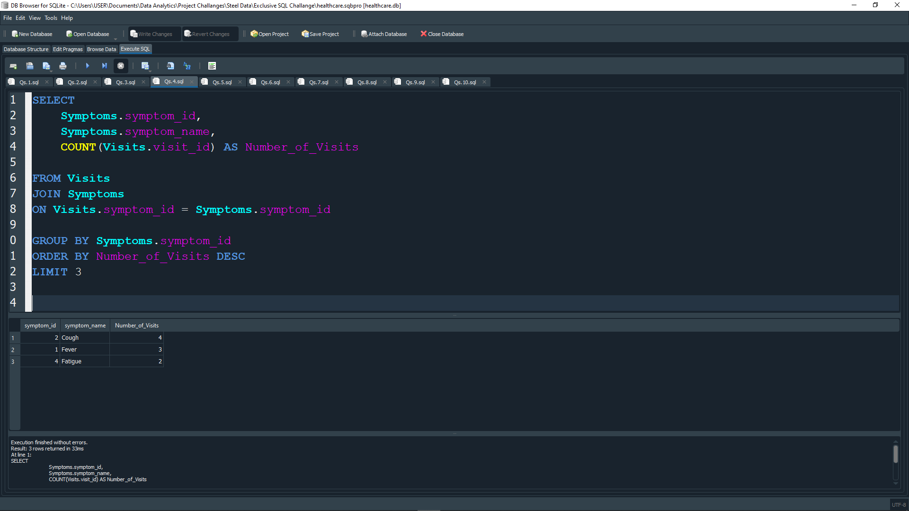
Question 4 Write A SQL query to retrieve the top 3 most common symptoms among all visits.

Slide 8
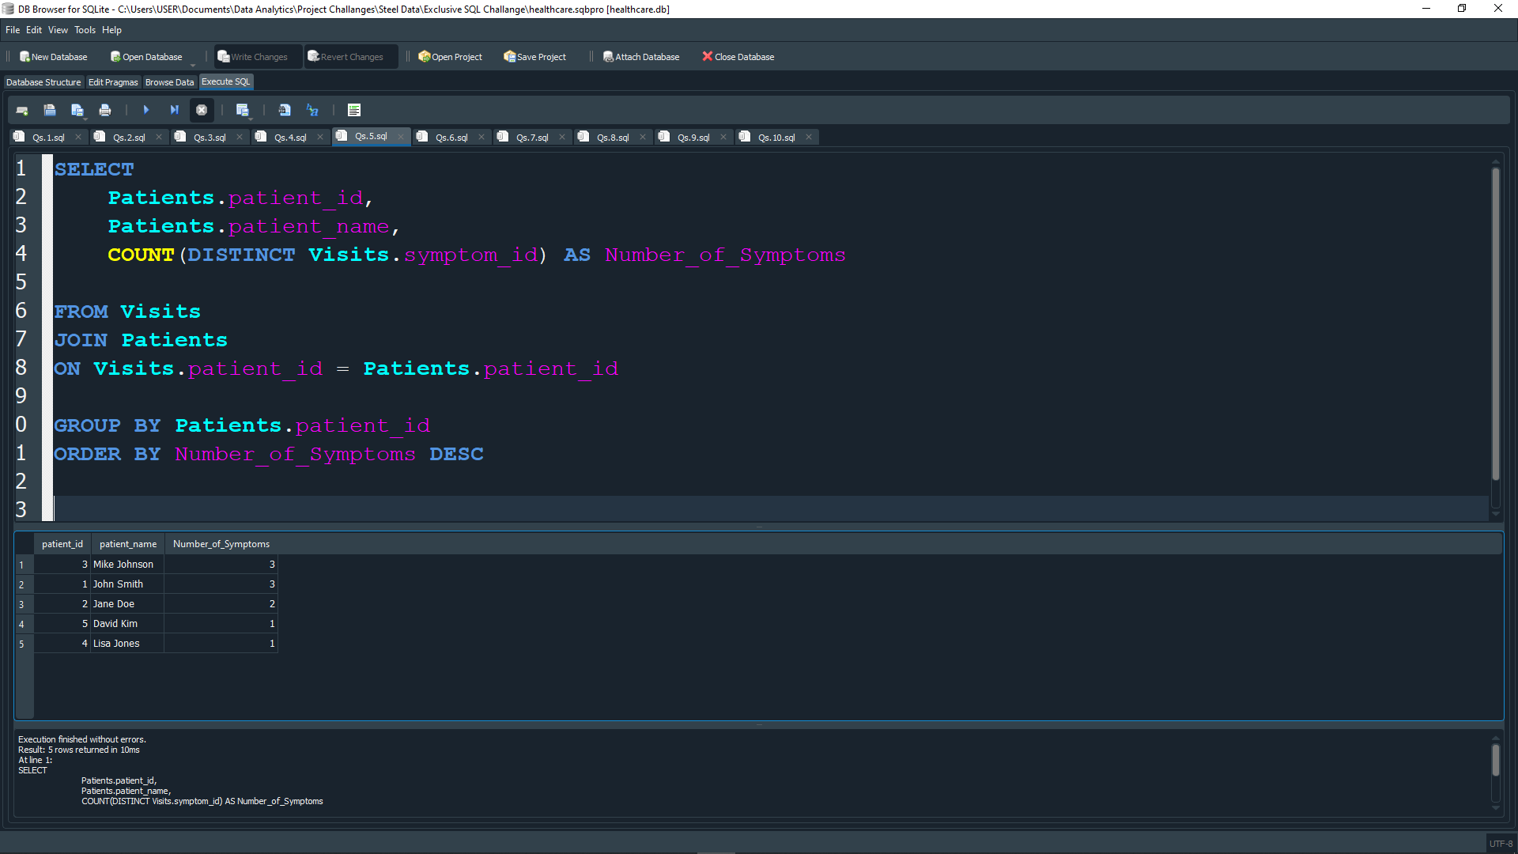
QUESTION 5: Write a SQL query to retrieve the patient who has the highest number of different symptoms reported.

Slide 9
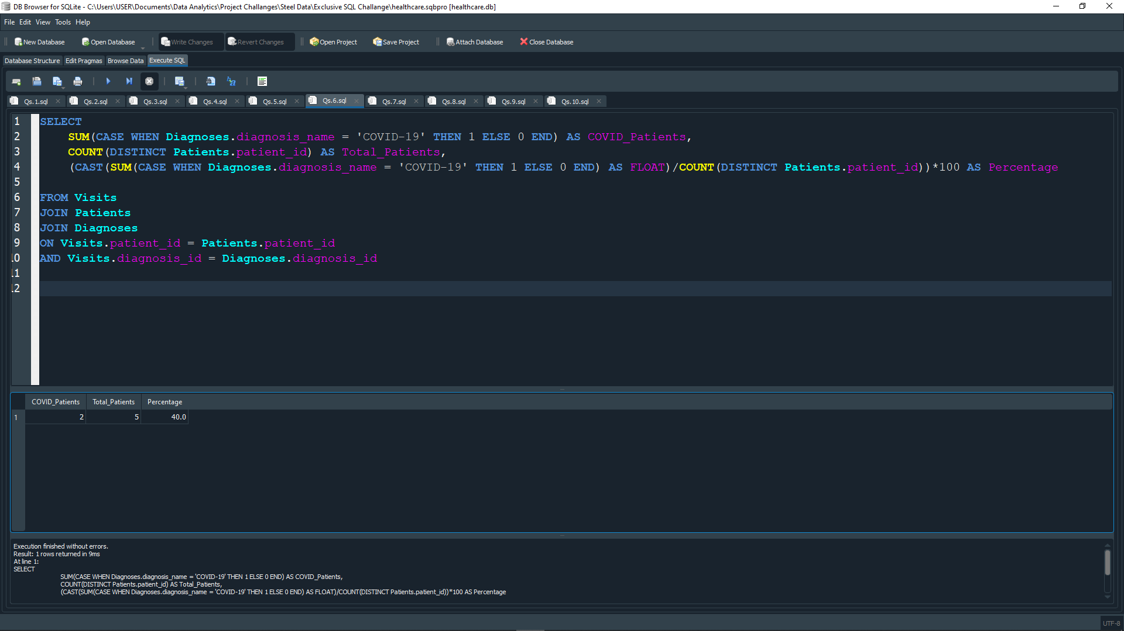
QUESTION 6: Write a SQL query to calculate the percentage of patients who have been diagnosed with ‘COVID-19’ out of the total number of patients.

Slide 10
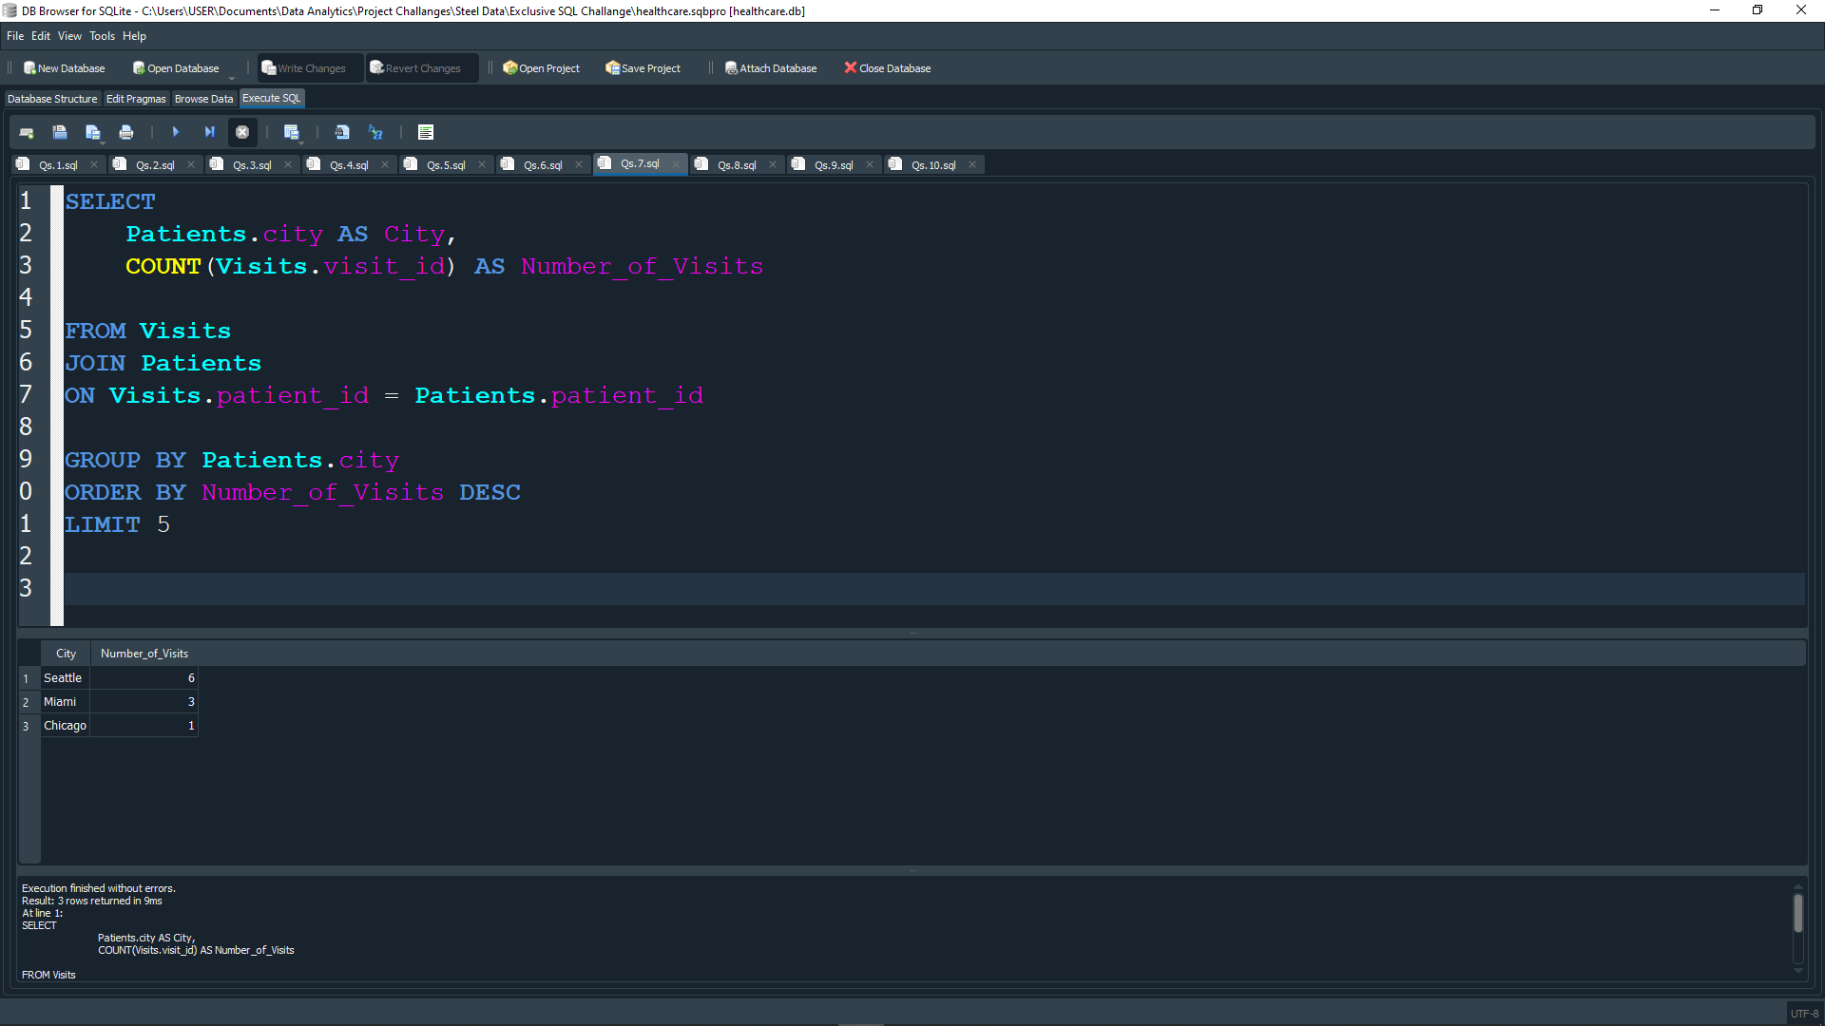
QUESTION 7: Write a SQL query to retrieve the top 5 cities with the highest number of visits, along with the count of visits in each city.

Slide 11
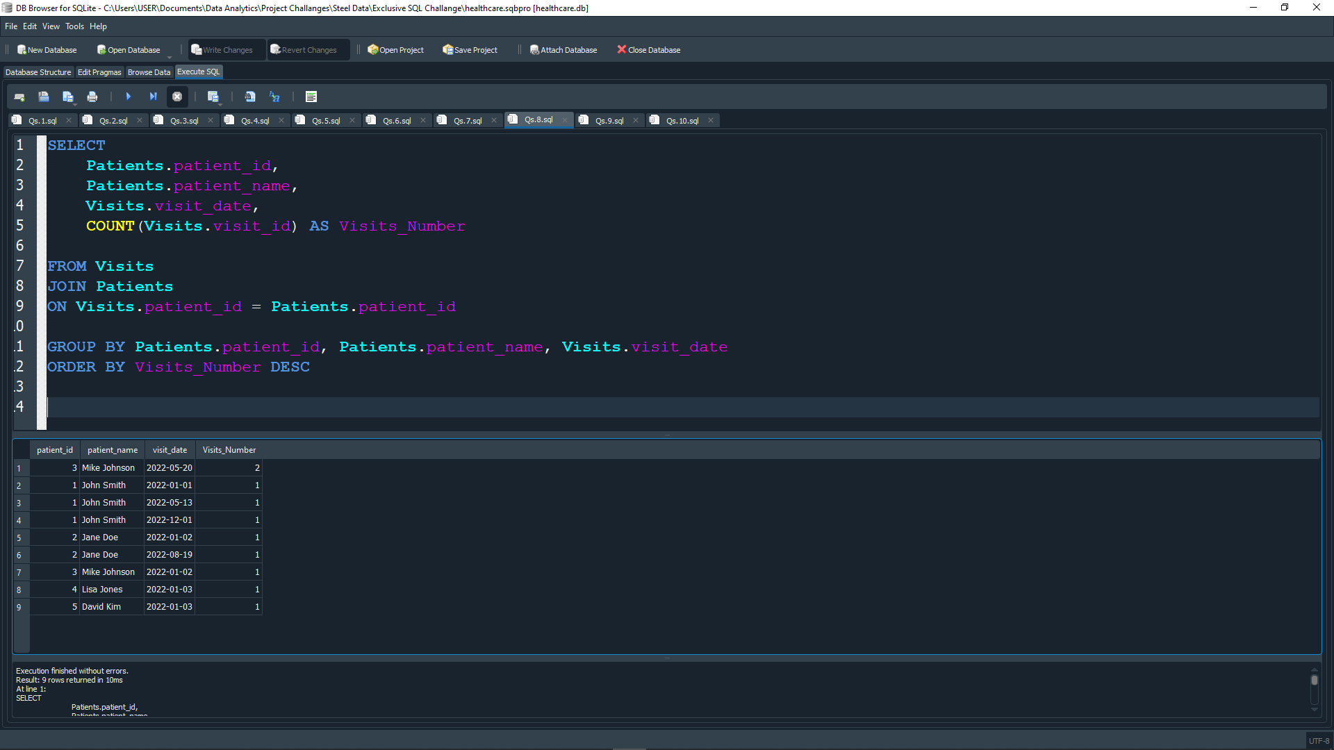
QUESTION 8: Write A SQL query to find the patients with the highest number of visits in a single day, along with the corresponding visit date.

Slide 12
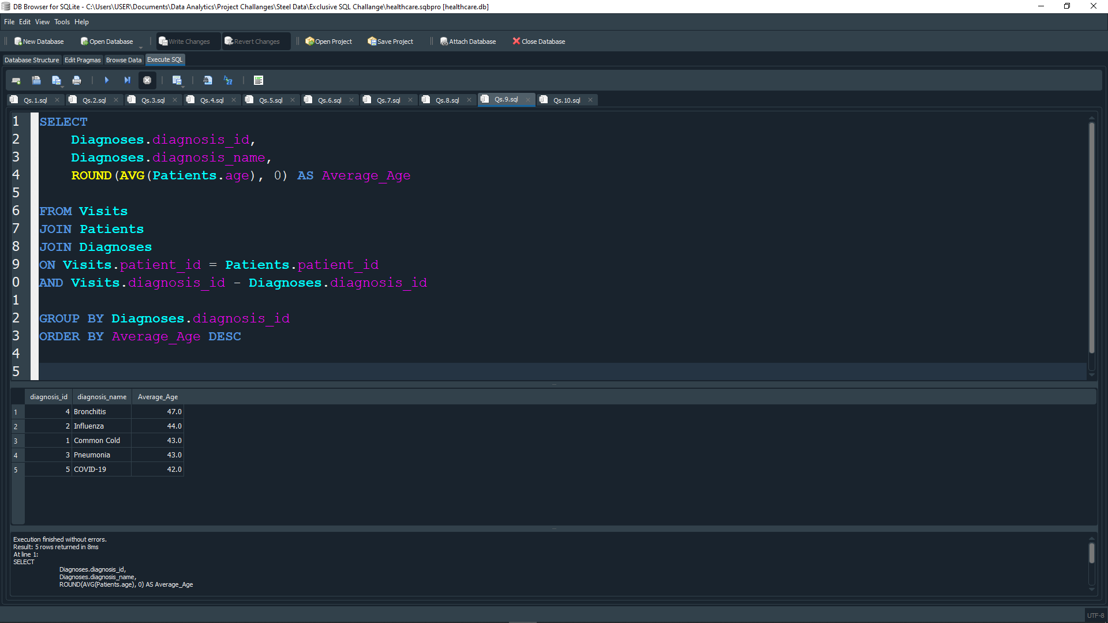
QUESTION 9: Write a SL query to retrieve the average age of patients for each diagnosis, ordered by the average age in descending order.

Slide 13
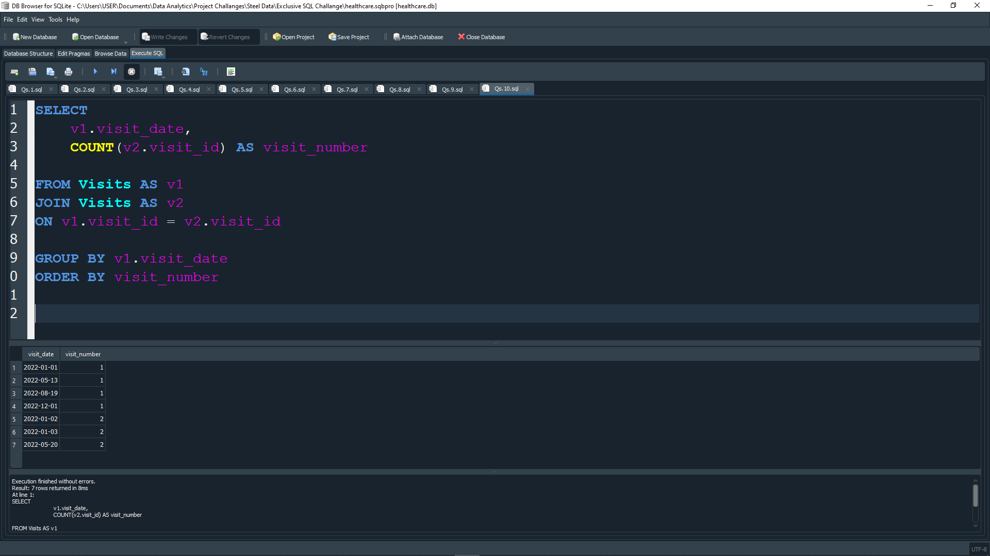
QUESTION 10: Write a SQL query to calculate the cumulative count of visits over time, ordered by the visit date.

Slide 14
Thank you

